Slide 1
INF10025
Data Management and Analytics
Lecture 6 – Part 2
Inner Joins

Slide 2
SQL: Query involving two tables
So far our SQL queries have retrieved data from a single table.
Often a query needs to retrieve data from two tables.
Usually the tables are related via Foreign Key / Primary Key relationships
  E.g. List all subject codes and their matching convenor names
SubjectCode | LecName
INF11002 | John Smith
INF11007 | Carol Kent
INF35700 | John Smith
INF35606 | Jane Pitt
SUBJECT
LECTURER
SubjectCode | Title | CreditPoints | LecId
INF11002 | Intro to Web | 12.5 | 207
INF11007 | EBIS | 12.5 | 345
INF35700 | Honours Project | 50 | 207
INF35606 | Media Thesis A | 25 | 119
LecID | LecName | Age
207 | John Smith | 37
119 | Jane Pitt | 26
345 | Carol Kent | 34

Slide 3
SQL: Query involving two tables
Suppose we write this:
  SELECT SubjectCode, LecName FROM Subject, Lecturer
The result set seems wrong. Every row in the first table has been matched with every row in the second table
This is called a Cartesian Product
A Cartesian Product is usually a mistake
SubjectCode | LecName
INF11002 | John Smith
INF11002 | Jane Pitt
INF11002 | Carol Kent
INF11007 | John Smith
INF11007 | Jane Pitt
INF11007 | Carol Kent
INF35700 | John Smith
INF35700 | Jane Pitt
INF35700 | Carol Kent
INF35606 | John Smith
INF35606 | Jane Pitt
INF35606 | Carol Kent
LECTURER
LecID | LecName | Age
207 | John Smith | 37
119 | Jane Pitt | 26
345 | Carol Kent | 34
SUBJECT
SubjectCode | Title | CreditPoints | LecId
INF11002 | Intro to Web | 12.5 | 207
INF11007 | EBIS | 12.5 | 345
INF35700 | Honours Project | 50 | 207
INF35606 | Media Thesis A | 25 | 119

Slide 4
SQL: Cartesian Product problem
A Cartesian Product occurs because
  Select statements ignore all referential integrity constraints that
  may have already been implemented
  So an SQL Select statement does not 'know' how two tables are related (it doesn't consider any existing FK – PK constraints)
    Why? SQL has to allow for queries based on non-related tables (perhaps even originating in different databases).
Solution
  You must specify how two tables are related
  in every Select statement that you write
  This is known as a Join
  There are a few ways that tables can be joined
    We will concentrate on Inner Joins

Slide 5
SQL: Inner Joins
An Inner Join returns a result set that contains
only data that satisfies a Foreign Key – Primary Key condition
Syntax: SELECT <column-names>
FROM <table-name1>
INNER JOIN <table-name2>
ON <join-condition>
The <join-condition> is normally in the format
  <foreign-key column-name> = <primary-key column name>
  SELECT S.SubjectCode, L.LecName
  FROM Subject S
  INNER JOIN Lecturer L
  ON S.LecId = L.LecId

Slide 6
SQL: Inner Joins
Each row in Subject will only be joined with a row in Lecturer
where the Foreign Key – Primary Key condition is satisfied
SELECT S.SubjectCode, L.LecName
FROM Subject S
INNER JOIN Lecturer L
ON S.LecId = L.LecId
RESULT SET SubjectCode | LecName
INF11002 | John Smith
INF11007 | Carol Kent
INF35700 | John Smith
INF35606 | Jane Pitt
SUBJECT
LECTURER
SubjectCode | Title | CreditPoints | LecId
INF11002 | Intro to Web | 12.5 | 207
INF11007 | EBIS | 12.5 | 345
INF35700 | Honours Project | 50 | 207
INF35606 | Media Thesis A | 25 | 119
LecID | LecName | Age
207 | John Smith | 37
119 | Jane Pitt | 26
345 | Carol Kent | 34

Slide 7
Column Prefixes
SQL interpreters are smart.
If every column name used in a query then alias prefixes are not required*
SELECT SubjectCode, Title, CreditPoints, LecName
FROM Subject S
INNER JOIN Lecturer L
ON S.LecId = L.LecId
No alias used
Alias prefix must be used
SUBJECT
LECTURER
SubjectCode | Title | CreditPoints | LecId
INF11002 | Intro to Web | 12.5 | 207
INF11007 | EBIS | 12.5 | 345
INF35700 | Honours Project | 50 | 207
INF35606 | Media Thesis A | 25 | 119
LecID | LecName | Age
207 | John Smith | 37
119 | Jane Pitt | 26
345 | Carol Kent | 34

Slide 8
Column Prefixes
Generally, database professionals prefix all column names with aliases in their SQL
- even when the code only uses 1 table
- even if all columns names are unique
- Future-proofs queries. A query may be modified to include new tables / columns.
SELECT S.SubjectCode, S.Title, S.CreditPoints, L.LecName
FROM Subject S
INNER JOIN Lecturer L
ON S.LecId = L.LecId
* Always use Alias prefixes
SUBJECT
LECTURER
SubjectCode | Title | CreditPoints | LecId
INF11002 | Intro to Web | 12.5 | 207
INF11007 | EBIS | 12.5 | 345
INF35700 | Honours Project | 50 | 207
INF35606 | Media Thesis A | 25 | 119
LecID | LecName | Age
207 | John Smith | 37
119 | Jane Pitt | 26
345 | Carol Kent | 34

Slide 9
SQL: Avoid old style Joins
Back in the dark ages (pre 2000), some DBMS products
did NOT use/have the Inner Join keyword.
  Instead the Join was expressed as part of the where clause within the Select statement
Many old-time developers, old-time web sites, old-time books & authors still use this old-style in their code and in their examples
SELECT S.SubjectCode, L.LecName
FROM Subject S, Lecturer L
WHERE S.LecId = L.LecId

Slide 10
SQL: Avoid old style Joins
This old style join gets confusing when you add
other restriction criteria to your where clause. Avoid old style join.
  The Where clause
    becomes cluttered and complex:
    may require use of additional brackets
    Becomes source of bugs
      these two examples will produce different results
SELECT S.SubjectCode, L.LecName
FROM Subject S, Lecturer L
WHERE S.LecId = L.LecId
AND L.Age > 50
OR L.Title = 'Professor'
SELECT S.SubjectCode, L.LecName
FROM Subject S, Lecturer L
WHERE S.LecId = L.LecId
AND ( L.Age > 50
OR L.Title = 'Professor' )
When you think you have mastered SQL (say in 4 weeks time) then try to uses this old-style technique.
You will see it used in industry by dinosaur SQL developers
(anyone over 42 years of age)

Slide 11
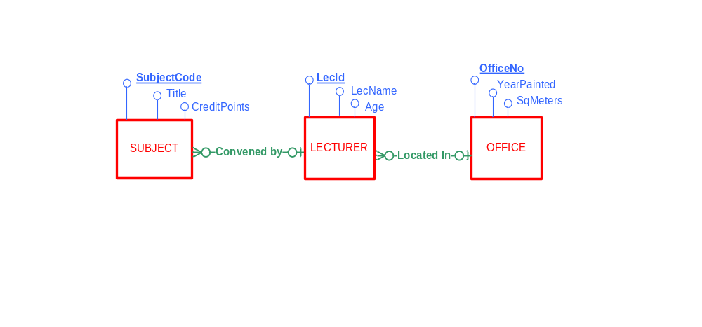
ERD with multiple relationships
The ERD below has been modified and has an additional relationship
  One Lecturer May be Located in ONE office
  One Office May have MANY Lecturers
Remember:
  Each M:1 relationship will always generate a FK in the relational model
  A FK is always located at the MANY end of a M:1 relationship

Slide 12
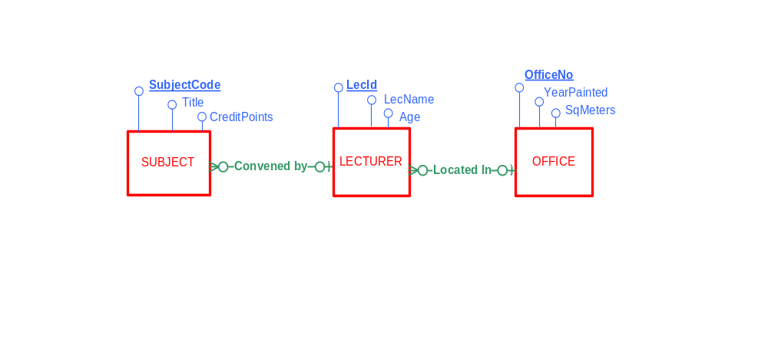
Convert ERD to Relational Model
  The ERD has two M:1 relationships
  The Relational Schema will have two FKs
  Each M:1 relationship generates a FK in the relational model
OFFICE (OfficeNo, YearPainted, SqMeters)
LECTURER (LecId, LecName, Age, OfficeNo)
Foreign Key (OfficeNo) References OFFICE
SUBJECT(SubjectCode, Title, CreditPoints, LecId)
Foreign Key (LecId) References LECTURER

Slide 13
SQL: Query involving two tables
Q. How large is the office of the convenor of INF11002?
Q. When was the office of the convenor of Media Thesis A last painted?
LECTURER
LecID | LecName | Age | OfficeNo
207 | John Smith | 37 | EN710
119 | Jane Pitt | 26 | EN505
345 | Carol Kent | 34 | EN710
SUBJECT
SubjectCode | Title | CreditPoints | LecId
INF11002 | Intro to Web | 12.5 | 207
INF11007 | EBIS | 12.5 | 345
INF35700 | Honours Project | 50 | 207
INF35606 | Media Thesis A | 25 | 119
OFFICE
OfficeNo | YearPainted | SqMeters
EN710 | 2004 | 12
EN505 | 2011 | 8.2
BA915 | 2007 | 10.5

Slide 14
SQL: Query involving 3 tables / 2 inner joins
This single SQL statement uses two Inner Joins to retrieve data from the
three related tables
SELECT S.SubjectCode, L.LecName, O.SqMeters
FROM Subject S
INNER JOIN Lecturer L
ON S.LecId = L.LecId
INNER JOIN Office O
ON L.OfficeNo = O.OfficeNo
ORDER BY L.LecName, S.SubjectCode
SUBJECTCODE | LECNAME | SQMETERS
INF11007 | Carol Kent | 12
INF35606 | Jane Pitt | 8.2
INF35700 | John Smith | 12
INF11002 | John Smith | 12
SUBJECT
SubjectCode | Title | CreditPoints | LecId
INF11002 | Intro to Web | 12.5 | 207
INF11007 | EBIS | 12.5 | 345
INF35700 | Honours Project | 50 | 207
INF35606 | Media Thesis A | 25 | 119
LECTURER
OFFICE
LecID | LecName | Age | OfficeNo
207 | John Smith | 37 | EN710
119 | Jane Pitt | 26 | EN505
345 | Carol Kent | 34 | EN710
OfficeNo | YearPainted | SqMeters
EN710 | 2004 | 12
EN505 | 2011 | 8.2
BA915 | 2007 | 10.5

